Slide 1
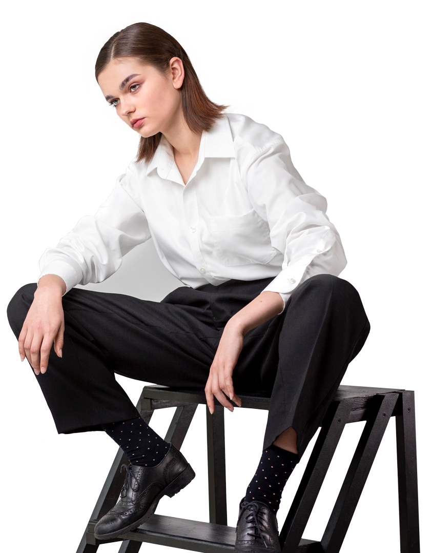
END Review
WBD
Project
Group - 26
Project Fasho
Vishnu Sai Varshith
S20190010076
Chetan Reddy Oruganti
S20190010129
Atharva Deshpande
S20190010043
Bharghav Sai Pendyala
S20190010017
Snehith K

Slide 2
TABLE OF CONTENTS
01
03
02
04
Project Idea
Final Status :)
Our wide vision and mission is to revolutionize and enhance the e-fashion experience.
The progress we are upto to accomplish our goals.
Business Case
Team Accomplishment
How this fantastic Cloth-Tech idea can generate large revenue.
The massive plans we have made to keep the bar up and high.

Slide 3
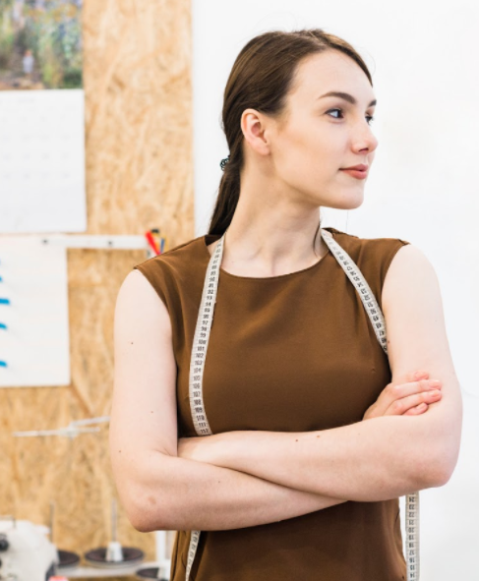
01
PROJECT
IDEA
The fantastic project idea we have to execute, that will see a change in the way online fashion industry works giving a great UI/UX!

Slide 4
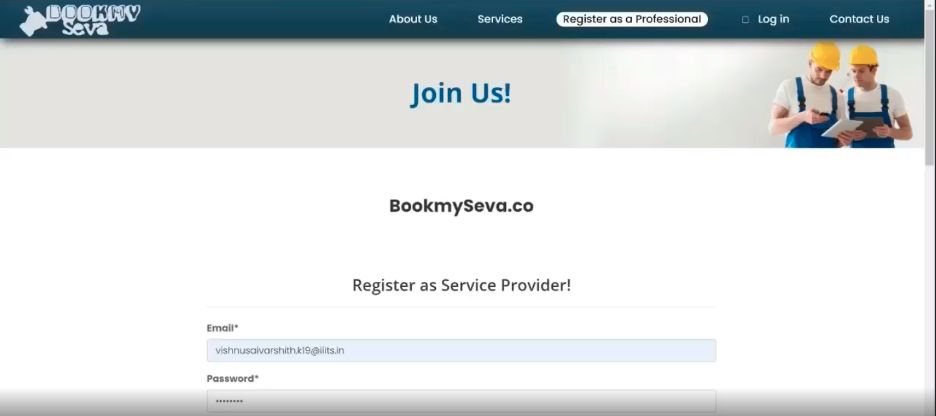
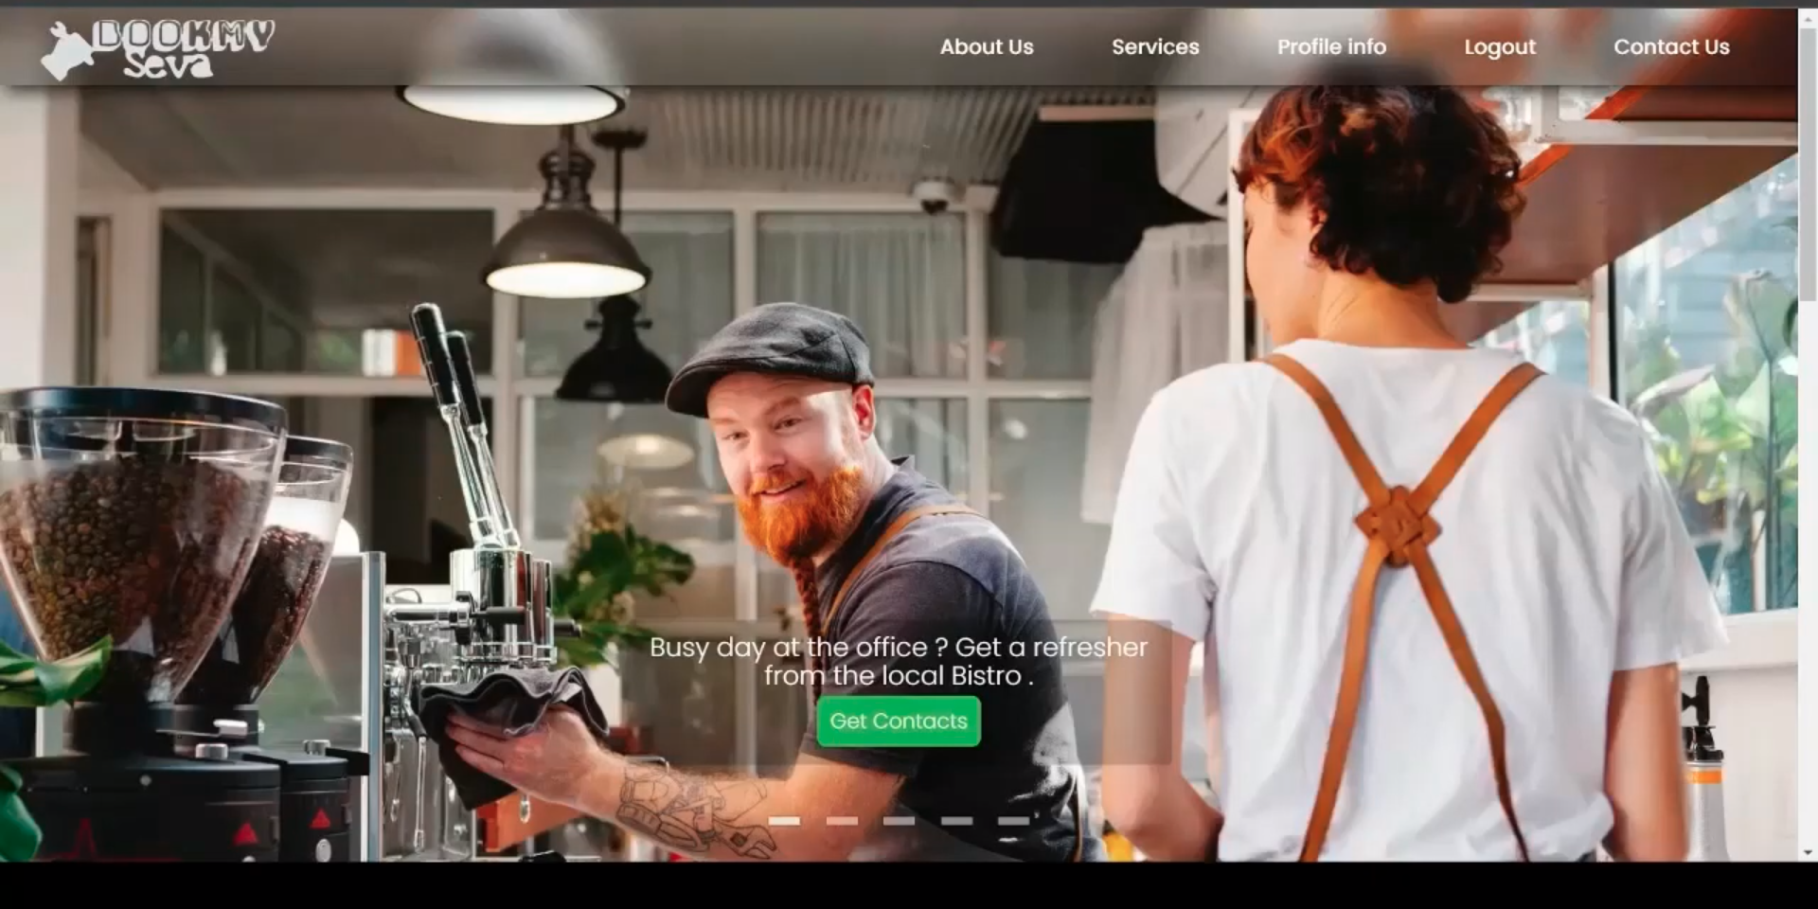
ABOUT US
We are the same team that successfully created bookmySeva.co, a django-based Web Application aimed at making basic human services available at one click following agile software development principles
With the same enthusiasm and zeal, our team has achieved some of the toughest and challenging endeavours ahead to showcase the web development skills each one of us possesses and bring better tech-products into the fashion industry.

Slide 5
MISSION
VISION
We are on a grand customer-oriented mission to build a never-seen-before
universal fashion web app that can:
Let you get fashion products based on personal choices with great User Experience.
Help you donate your worn out fashion products for recycling as a green initiative.
Help you find and buy wide range of categories of fashion apparel and authentic clothes based on your interest.
We strive to serve the best product in fashion-knit and fashion outerwear by empowering innovation and design to provide total customer satisfaction.
To innovate and provide best-value products and services to the customers.
To make a difference through our product design and stay ahead of market changes with the latest technology.

Slide 6
MODEL FEATURES
Great
Performance
Latest Technologies involved.
Best Front End Design
We have made good use of react components to derive aesthetic design solutions which is well also well supported by Chakra UI
With latest libraries and frameworks, at par with the likes of next.js we have made sure customers don’t have to wait a sec!
We are making use of the most trending tech stack in the web development industry which is not just limited to MERN stack

Slide 7
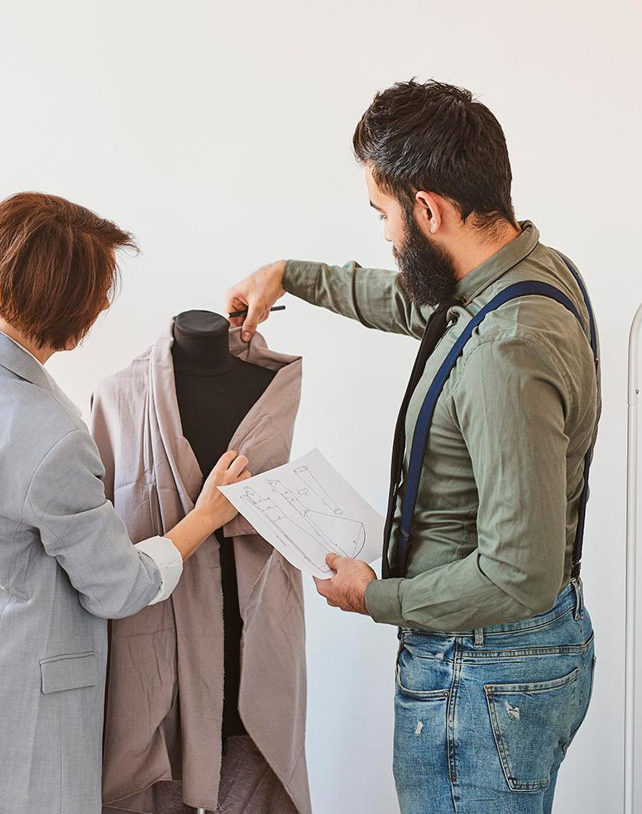
Project Fasho.Live
We, the team of 5 like-minded individuals, have committed ourselves to the project idea described before taking forward the business legacy of bookmySeva.

Slide 8
BUSINESS
CASE
02
How we think this business idea will generate money and earn us huge profits

Slide 9
Problem Statement
Background: Nowadays good clothes are hard to find at the last moment. If they are available locally, the prices aren't in our control and so is the reliability. Many climate-concerned people know the importance of recycling clothes. The fashion industry is responsible for 10 % of annual global carbon emissions, more than all international flights and maritime shipping. Hence, it is essential to recycle fashion products rather than throwing them away. The indiginous fashion industry has high quality products with desi-touch but due to small reach they do not find good number of customers sometimes even locally.
Statement: Making it easy to find good fashion apparel from the ease of your place, recycling options and proper market reach for indiginous clothing.
Business opportunities: Making the sellers get a marketplace to get a wider reach of customers, proper use of donated clothes which can be refurbished after cleaning to resell with a suitable price, getting grants/concessions from the government for green initiative and supporting local industry thus empowering the local youth, preserving the cultural heritage and making it global.

Slide 10
Proposed Solution
A web application with MERN Stack + Redux + Latest Libraries that can get the work easier.
Local sellers can reach out to outsource their products with us. This can earn profits from the clothes that feature on our web application, empowering them with stable job opportunities and returning huge profits mutually.
Customers who are concerned about climate change will donate their old or unused or unwearable clothes to us so as we can recycle them. The recycled clothes will be refurbished and our contracted tailors will make a good use of the recycled material to release fashionable clothes with valuable suggestions from our customer oriented fashion designers.
We will reach out to various higher and local level governments taking our causes that will seek us huge benefits whether in terms of taxes or incentives for our noble initiatives of recycling and supporting local industries. It will definitely help us financially.
Getting featured on climate-change concerned platforms will give us good reach initially. The local youth will get a recognition for the talent they possess and branding their products shall fetch us good amount of revenue.

Slide 11
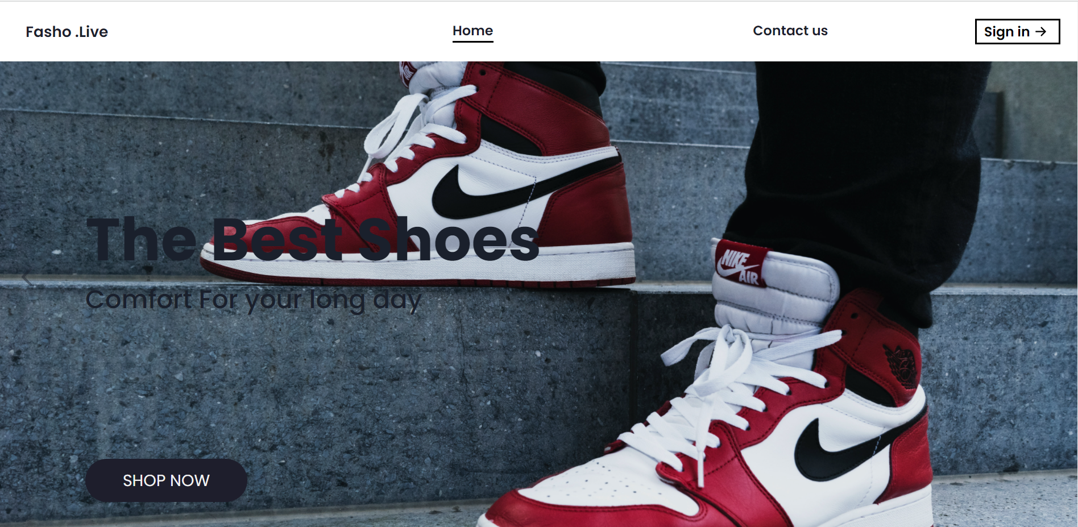
Implementation in React
Our code is based on MERN (Mongodb, Express, React and Node js) stack and Chakra UI.
Chakra UI is a simple, modular and accessible component library that gives us the building blocks needed to build our React application.
The fast generation of the product cards displayed in the pic is possible due to Chakra UI, a react based UI component library.
It has great support for light and dark mode, so our website keeps up with the latest trends
Our application successfully recognises the choices of user and adds each selected product to the cart.

Slide 12
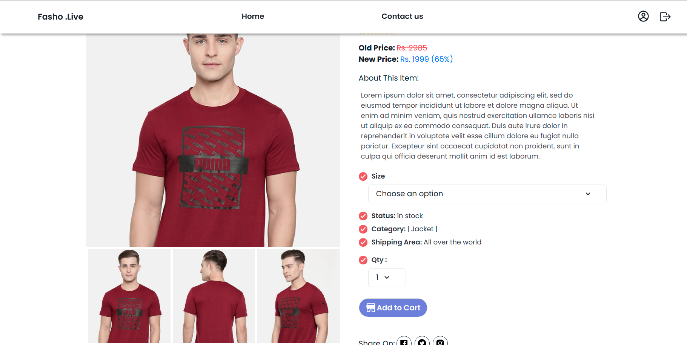
Implementation in React
On clicking a product card, our react application quickly directs a user to the product page where the user gets all the information of a product, be it price, size, quantity, reviews and section for comments on the product
On adding a product to the cart, our cart successfully holds the products that were selected
In the cart, user can view all the products instantly.
When the quantity of a product is changed, its state changes and after appropriate calculations the new price is rendered dynamically
Our application also filters the products listed based on their ratings, upload date and prices and updates the listing in the same page

Slide 13
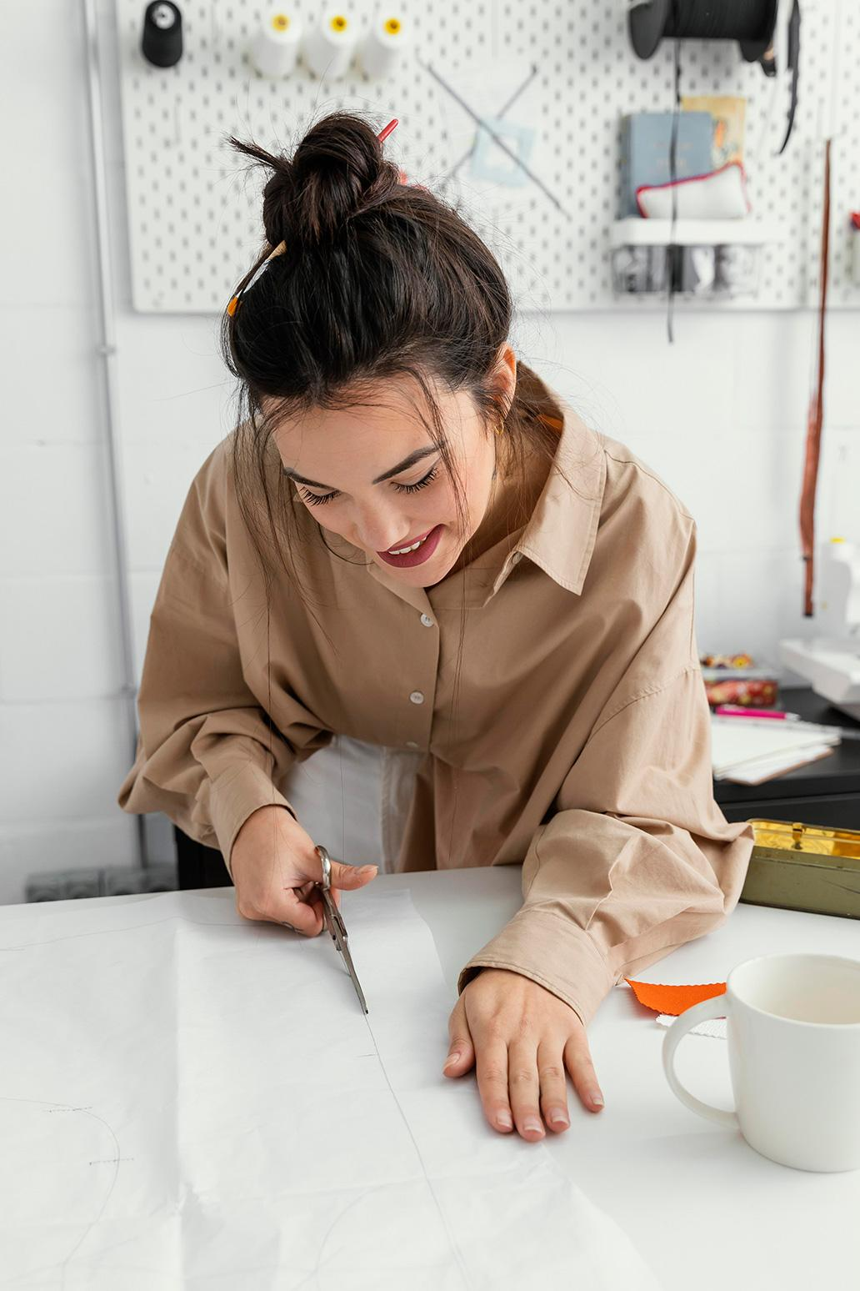
03
CURRENT
STATUS
What have we done and the milestones we have achieved so far!

Slide 14
Views of Application
All the products in men’s and women’s category are called from backend to display on homepage
All Products
Product
Details
All the product details like ratings, upload date and prices are fetched from the backend for each product having a valid id
Home page
User Info
Details of a user are fetched from the backend user database to authenticate a specific user
Donation
Info
Shows all the donation form details & status of donated products

Slide 15
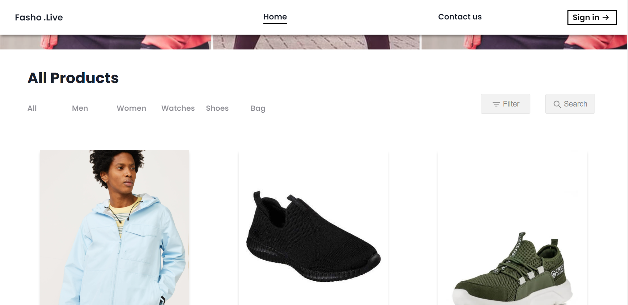
Views
Products

Slide 16
Views

Slide 17
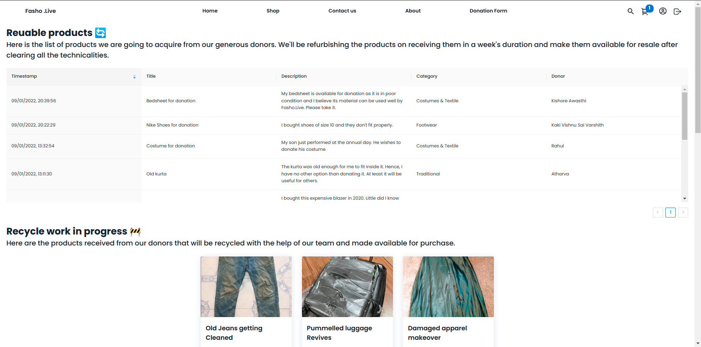
Views
Donation details

Slide 18
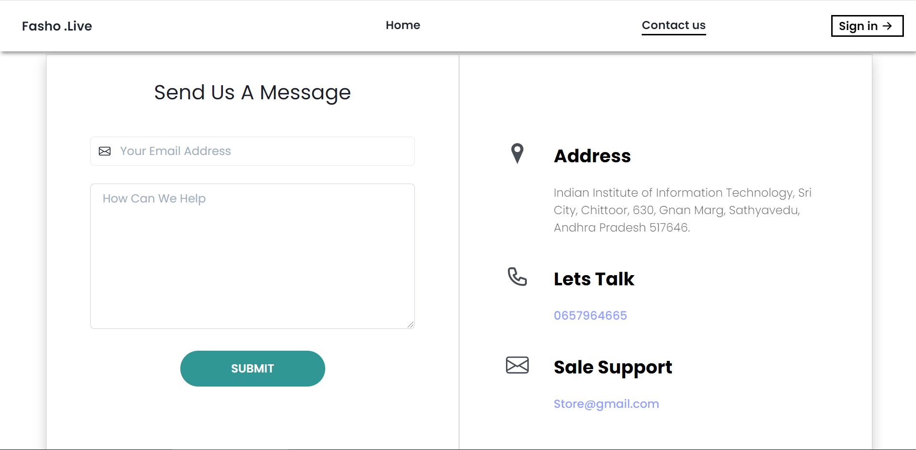
Forms
CONTACT US

Slide 19
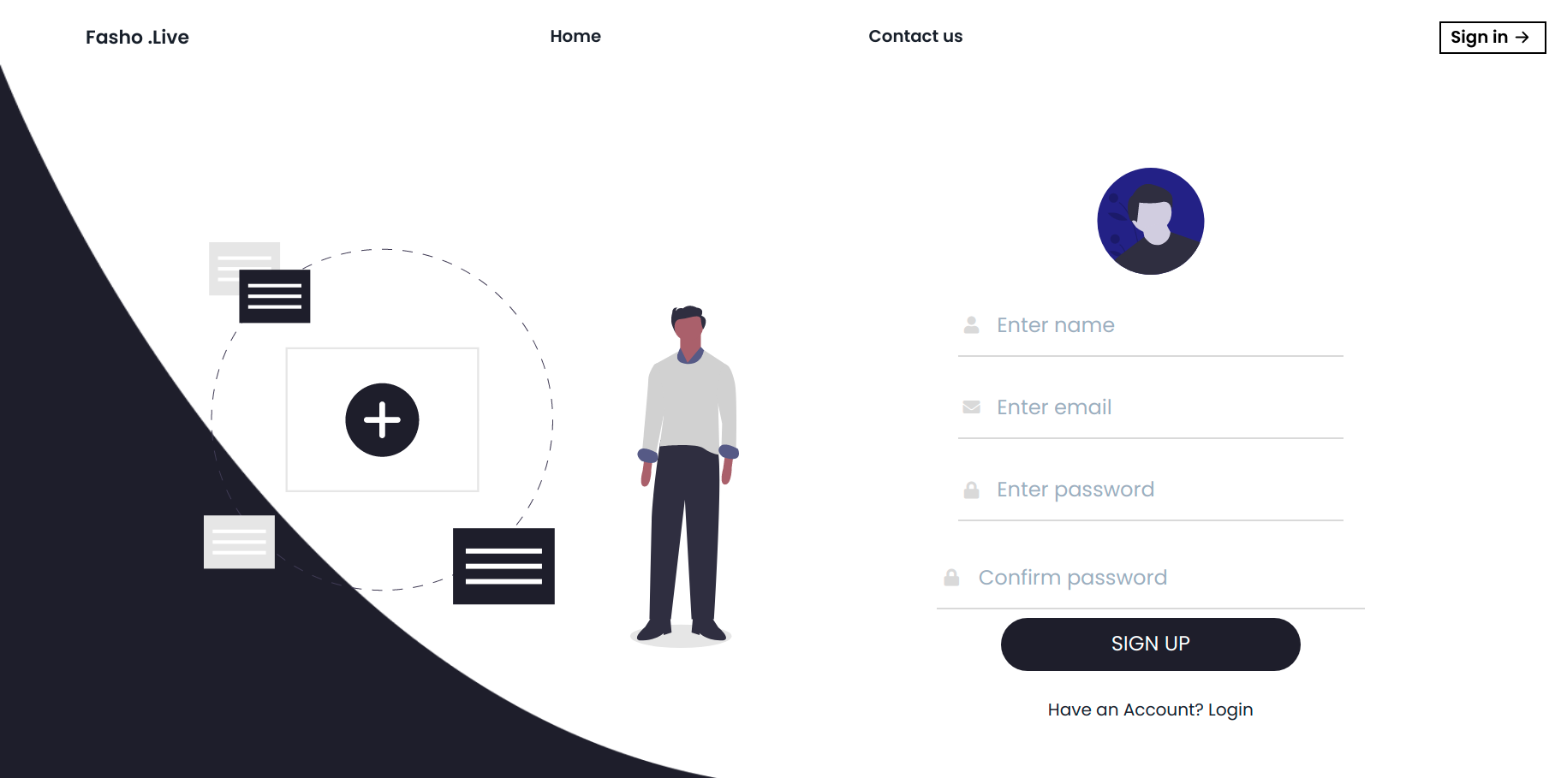
Forms
LOGIN / SIGN UP

Slide 20
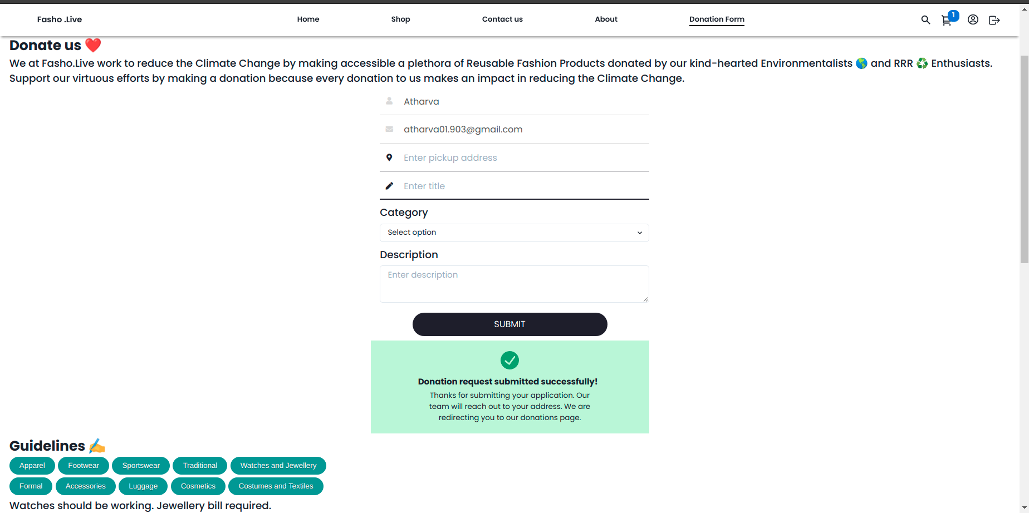
Forms
Donation form

Slide 21
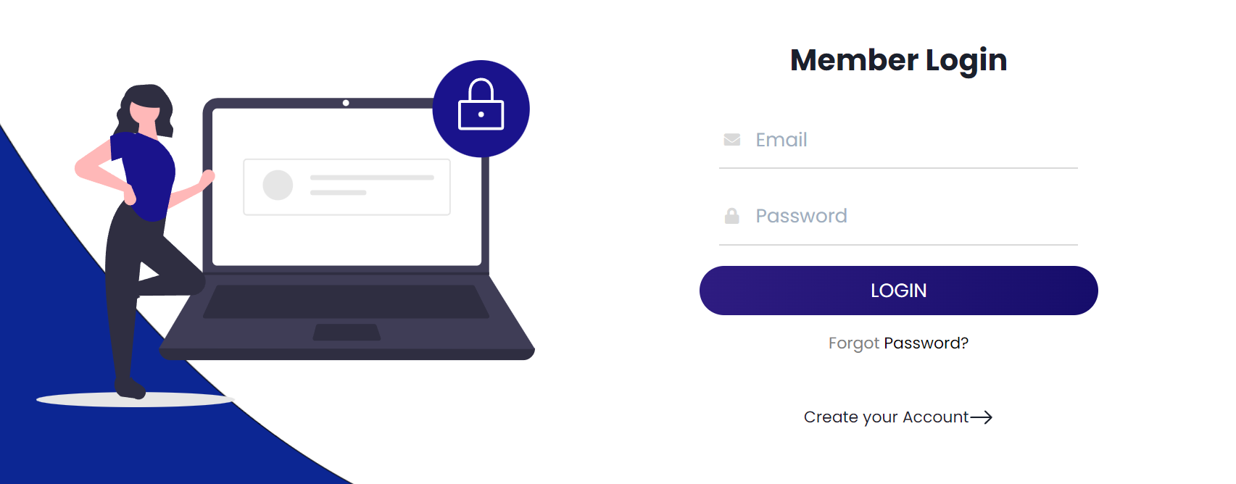
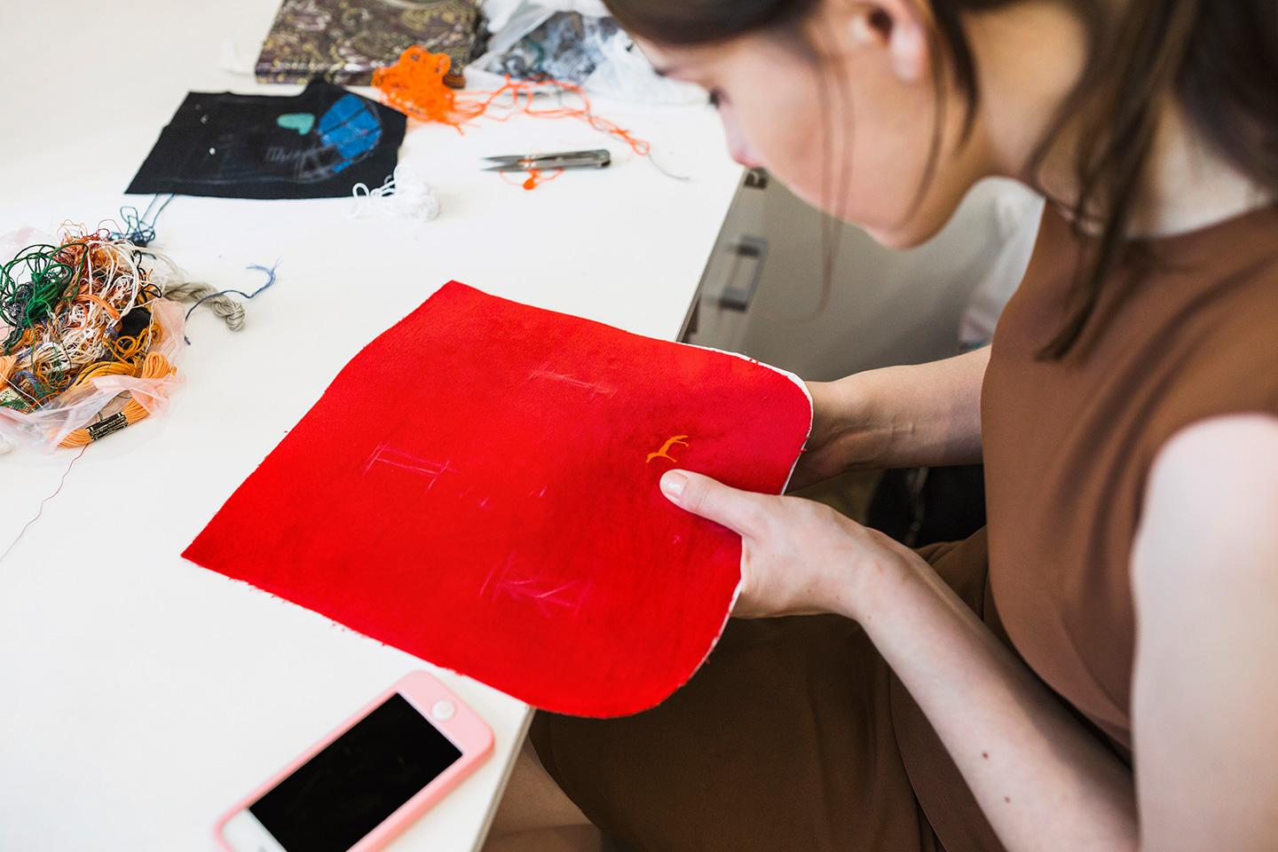
COMPUTER
MOCKUP

Slide 22
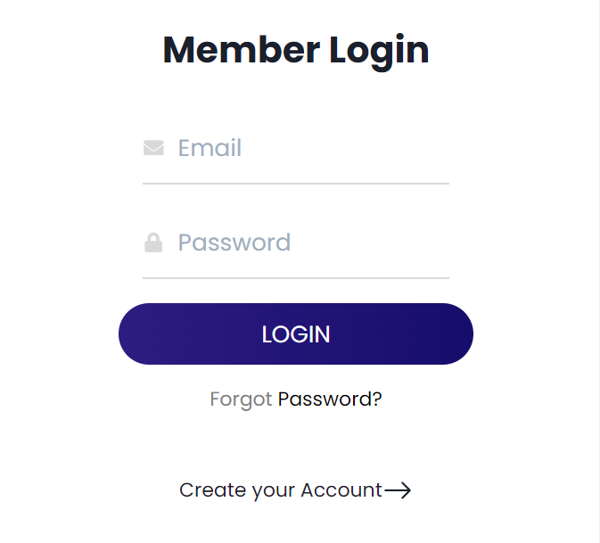
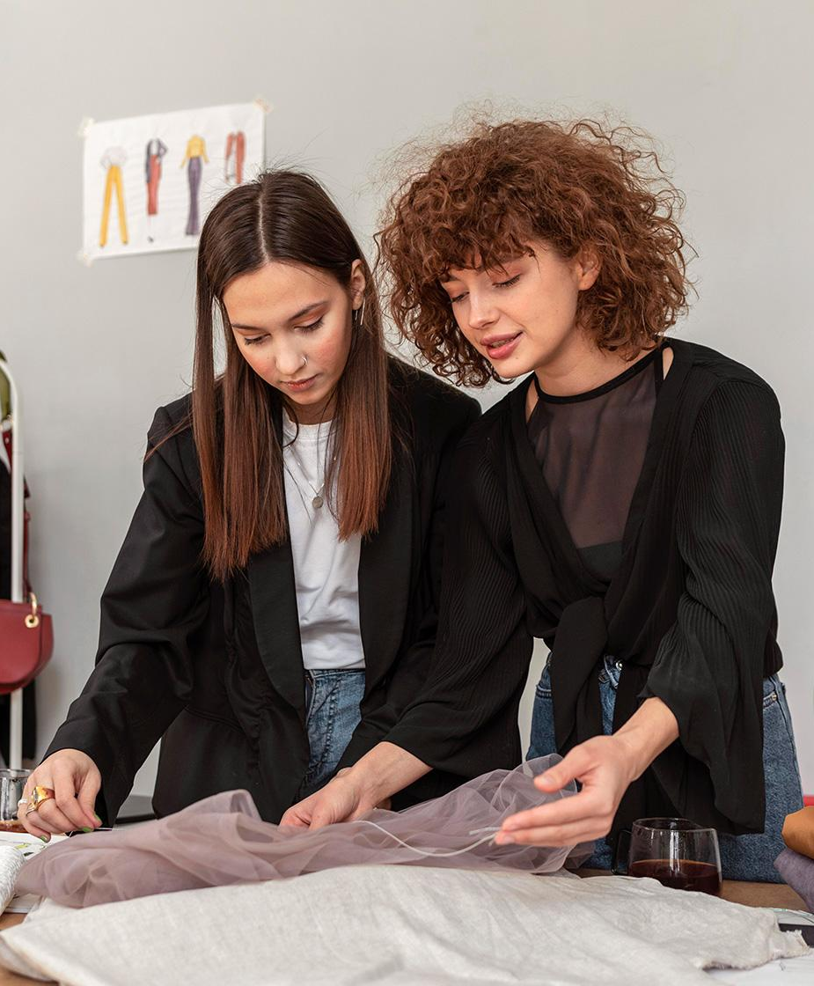
TABLET
MOCKUP

Slide 23
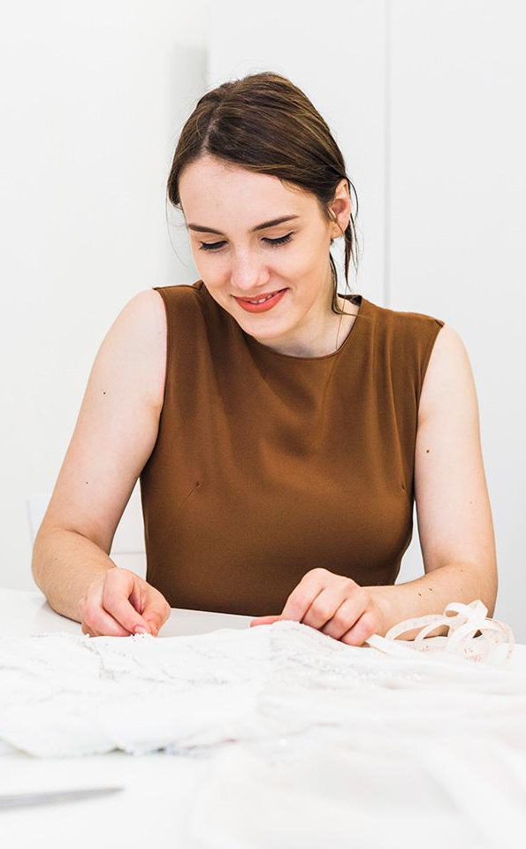
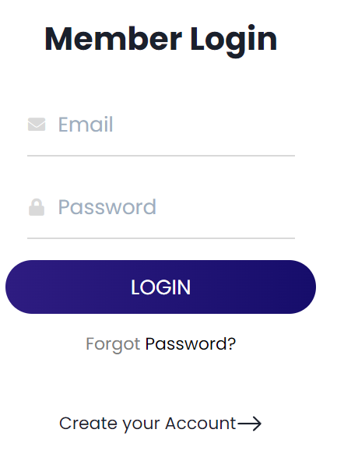
MOBILE
MOCKUP

Slide 24
DDD of Fasho.Live
Discount
Search Filter
Cart
Address
Products
Name
User
Payment
Invoice
Auth
Email
Donations
Donated Products
Recycled Products
Logistics

Slide 25
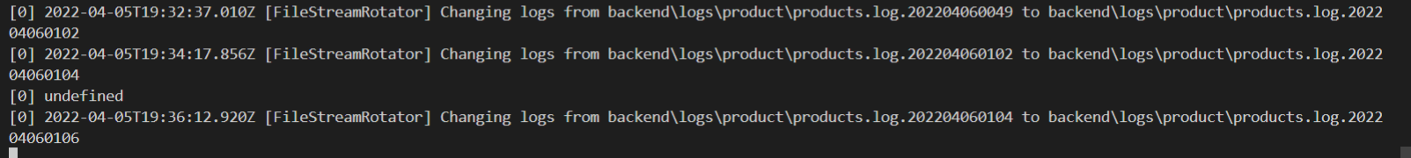
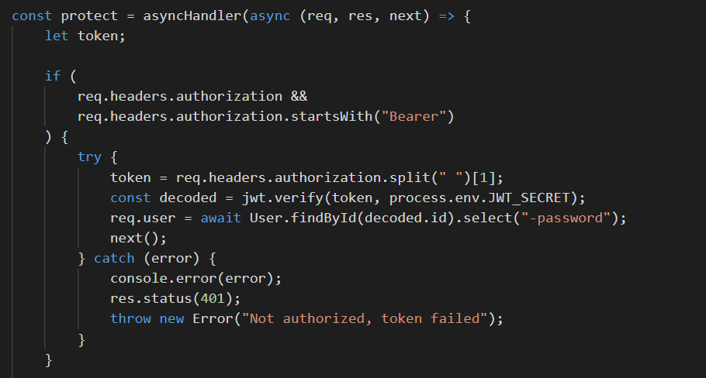
Middleware
Morgan for Logging
Multer for File Upload
JWT

Slide 26
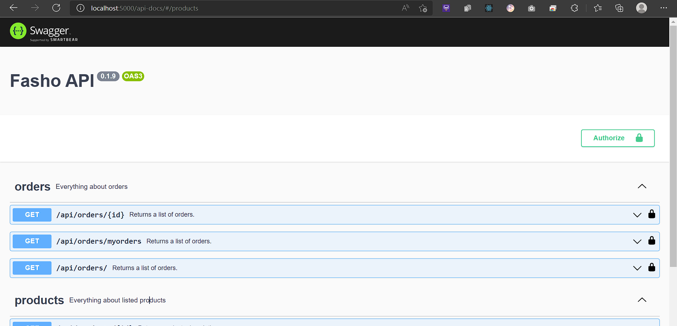
SWAGGER

Slide 27
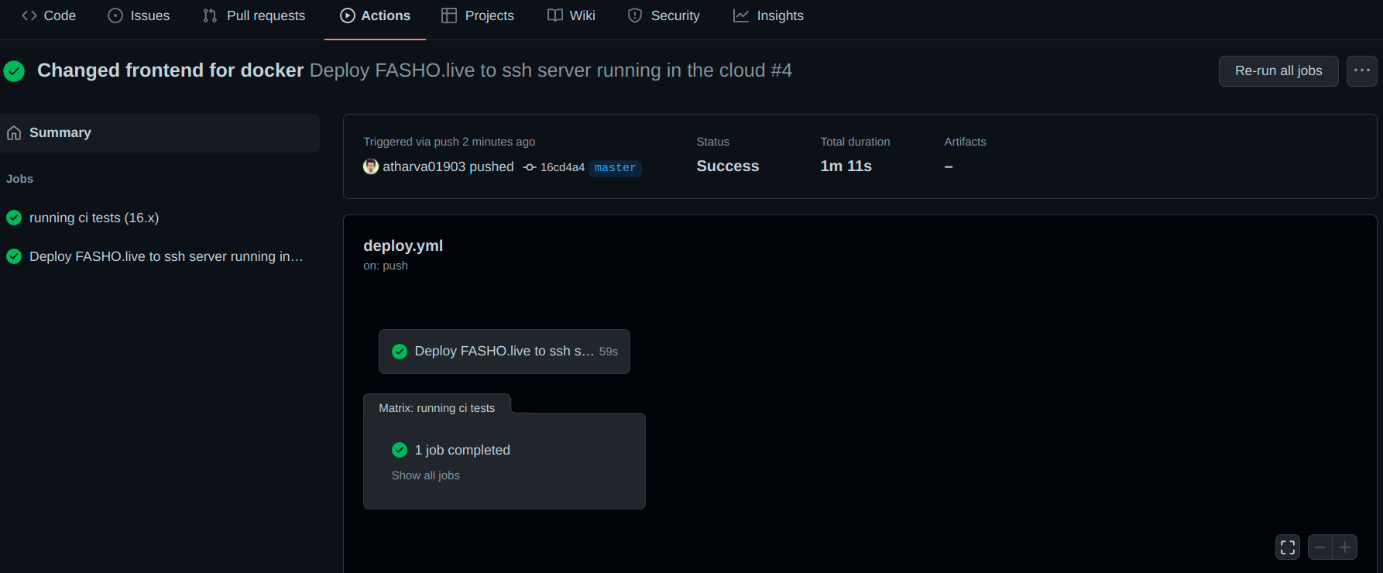
DOCKER

Slide 28
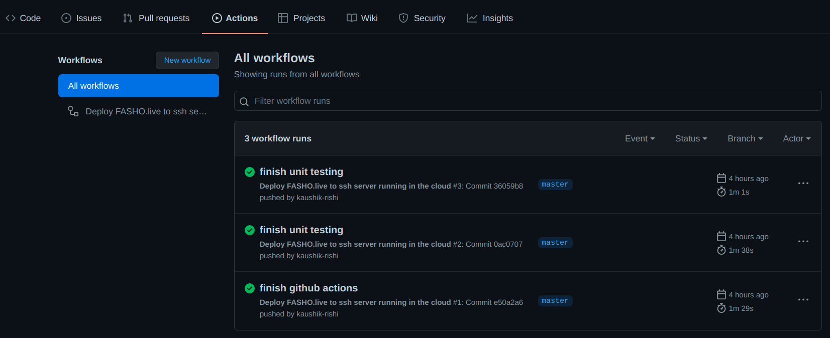
CI / CD

Slide 29
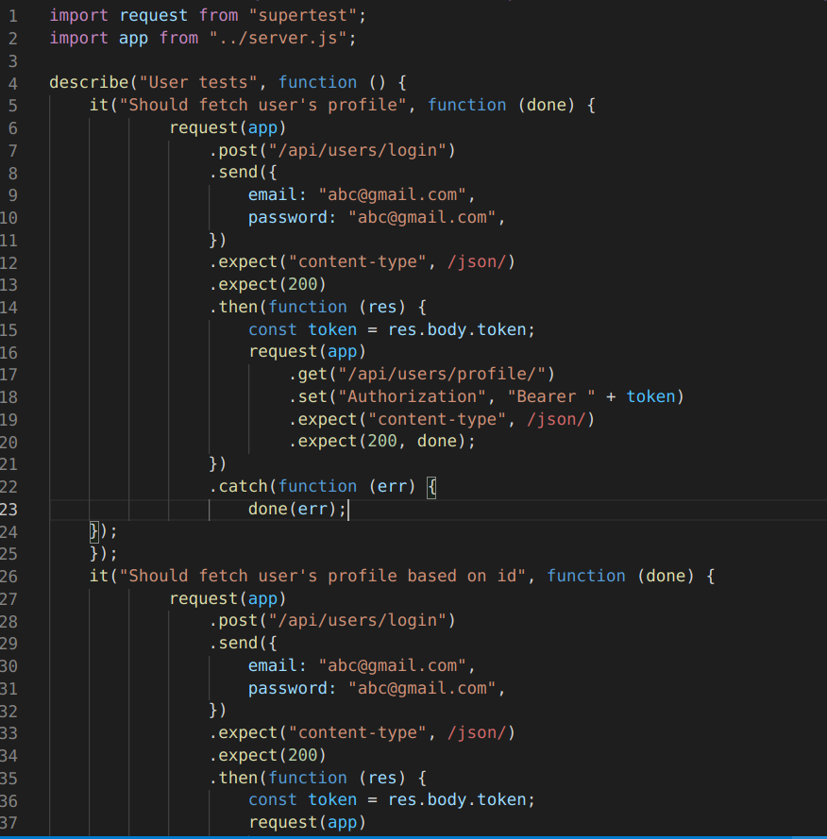
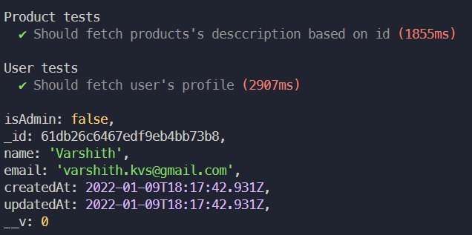
UNIT TESTING

Slide 30
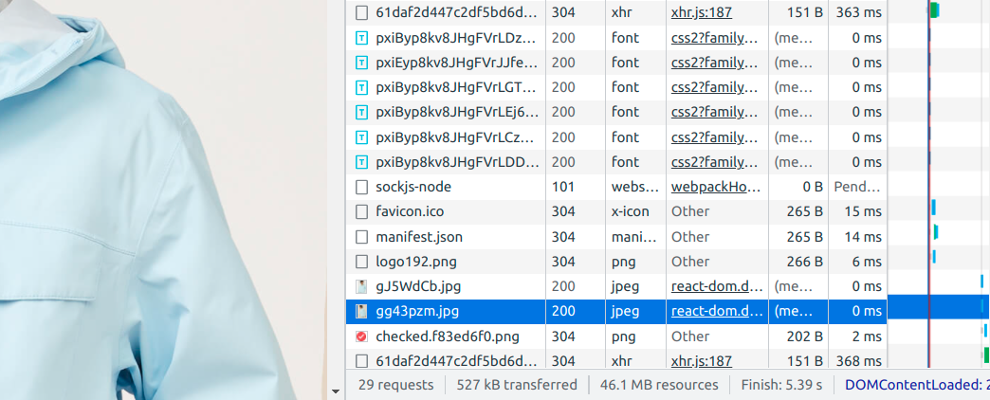
Caching for Optimization
Here a product image of size 103 kB was accessed in almost 0 ms which was taking 300 ms before

Slide 31
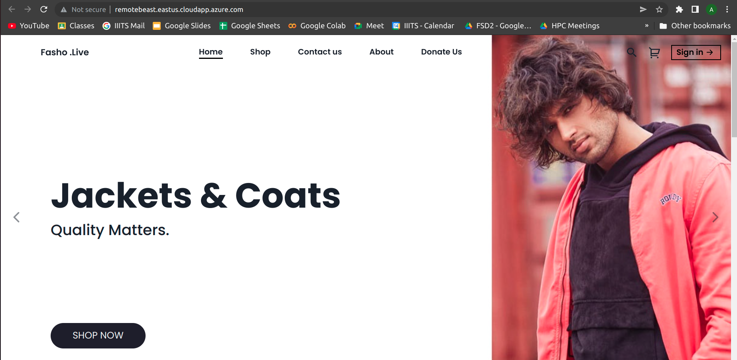
Deployment
URL: http://remotebeast.eastus.cloudapp.azure.com/

Slide 32
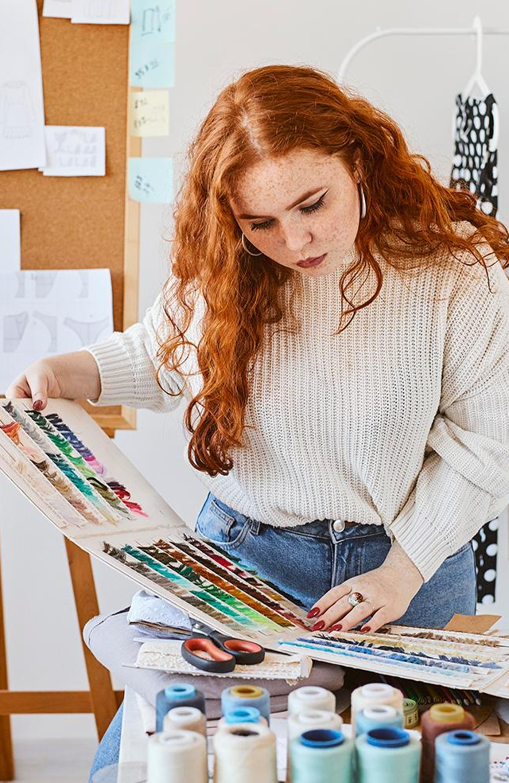
04
WORK DONE :)
The progress we desire to keep up in the near future and the strategy we have made up!

Slide 33
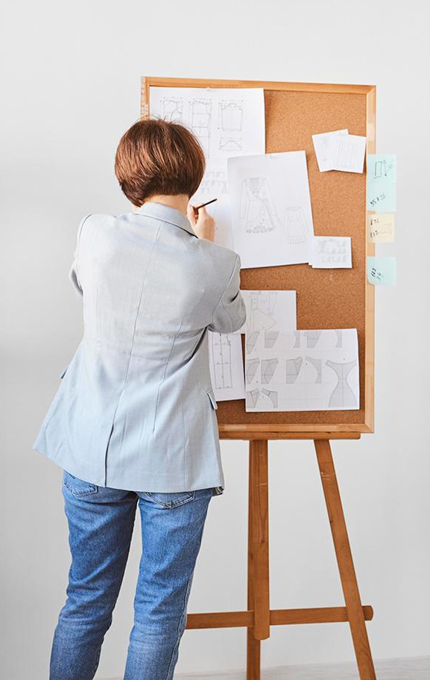
Milestones in WBD
To carry forward the legacy we have achieved in the FSD-2 season, learn new topics especially related to backend, cloud (dockerization) & cyber security, integrate them with the current achievements and deploy the application with the domain name Fasho.live

Slide 34
Project End Review Status
WHAT was Done!
 | MongoDB Integration
 | Swagger
 | Donate Feature
 | Middleware
WHAT has been Done!
 | CI/CD Integration
 | Deployment
 | Enhancing UI/UX
 | Bug Fixing, Docker

Slide 35
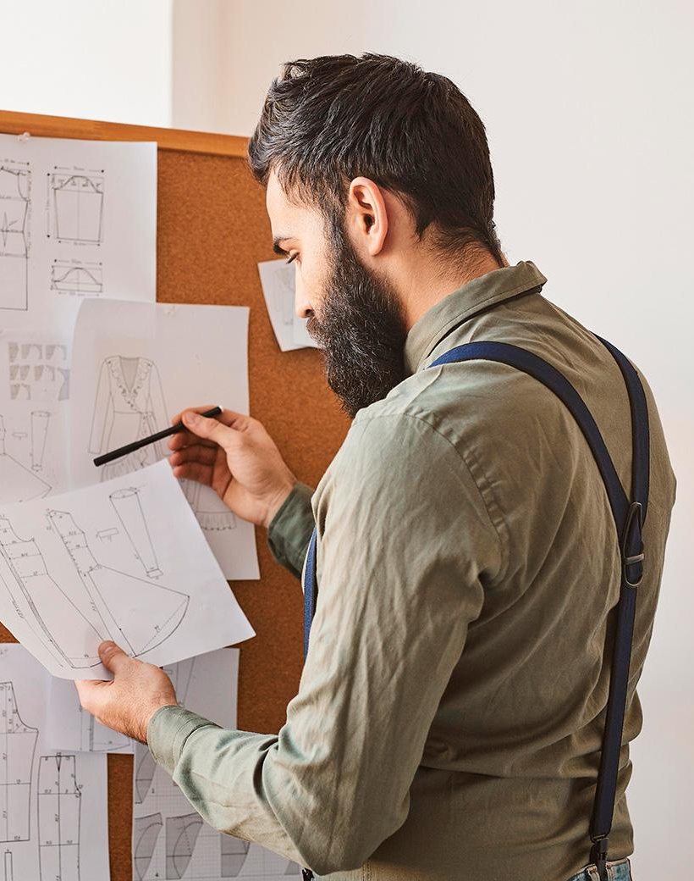
THANK
YOU
Questions & Suggestions please!

